Slide 1

Short story about AI Factory
Patrycja Dąbrowska – Wierzbicka, Marek Kasztelnik
14.04.2026

Slide 2
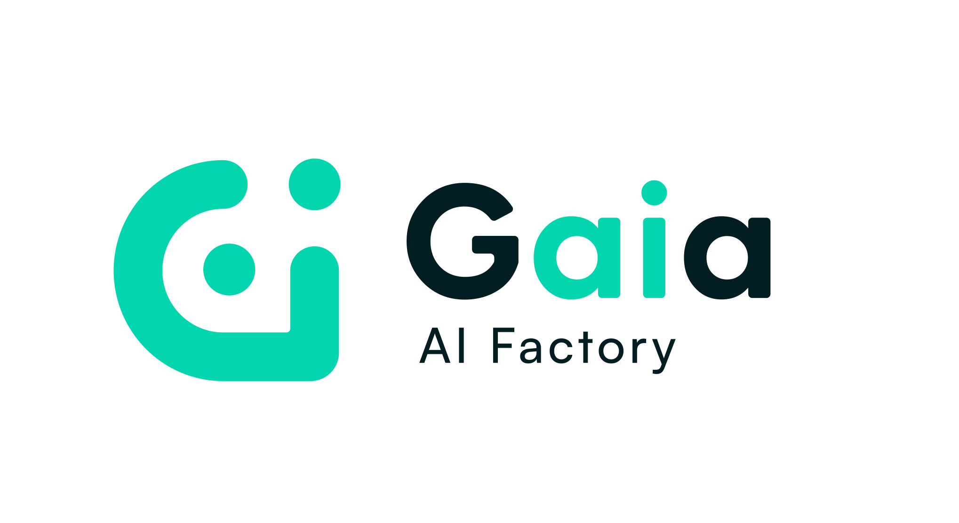

AI FACTORIES

Slide 3
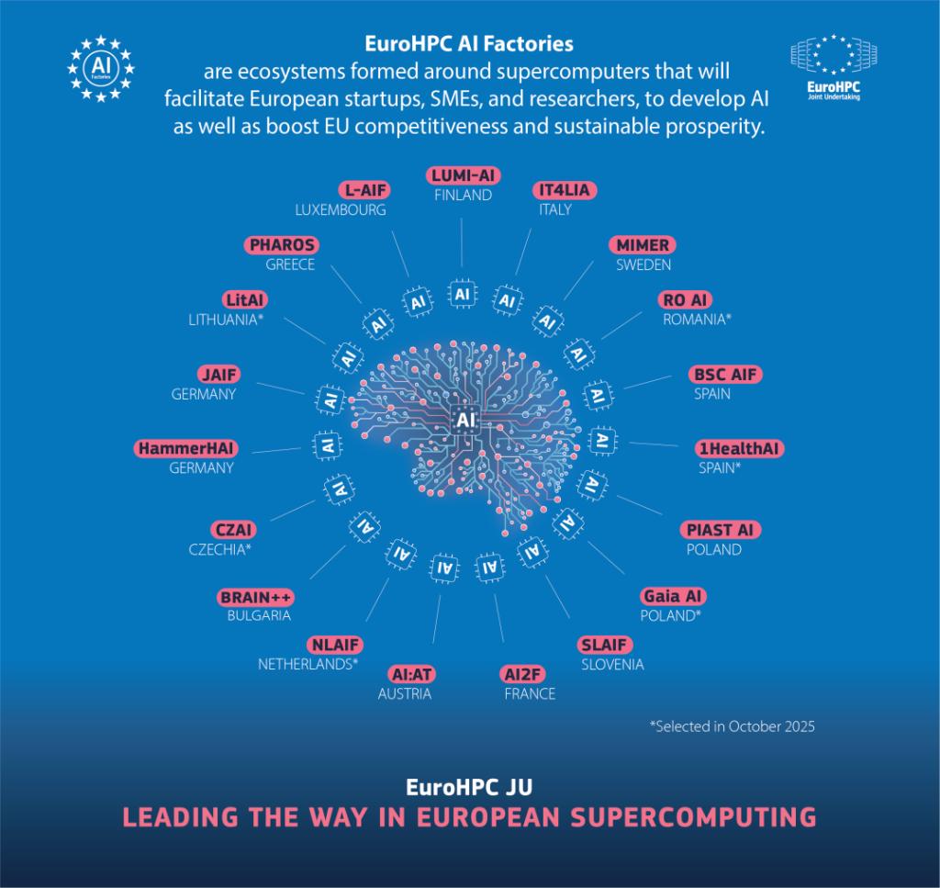
Why AI Factories?
Po

Slide 4


What are AI factories used for?
Input data → Processing (GPU)
→ AI model → Output
BUILDING AI COMPUTING
INFRASTRUCTURE
Tailored services
Expert support
SERVICE
AND INNOVATION HUB
digital sovereignty | strengthening European competitiveness | building trustworthy AI

Slide 5

AI FACTORIES CUSTOMERS
Researches
- focus on discovery, not infrastructure
- access to the world's top supercomputers
- datasets, support, and tools that used to exist inside the largest research institutions
SMEs
- skip the million-dollar infrastructure bill
- shorten the time from idea to deployment
- giving companies tools once limited to the largest players only
Public
- secure, accessible big data processing on European terms
- digital sovereignty beyond a policy goal — an infrastructure reality
Students
- talents pool
- cooperation with companies
- short-term courses & summer schools
- student common space

Slide 6











COOPERATIONS & PARTNERSHIPS

Slide 7
0 PLN
Startups and SMEs are subject to state aid rules

Slide 8

TIMELINE
already has started
planned start: May, 2026

Slide 9
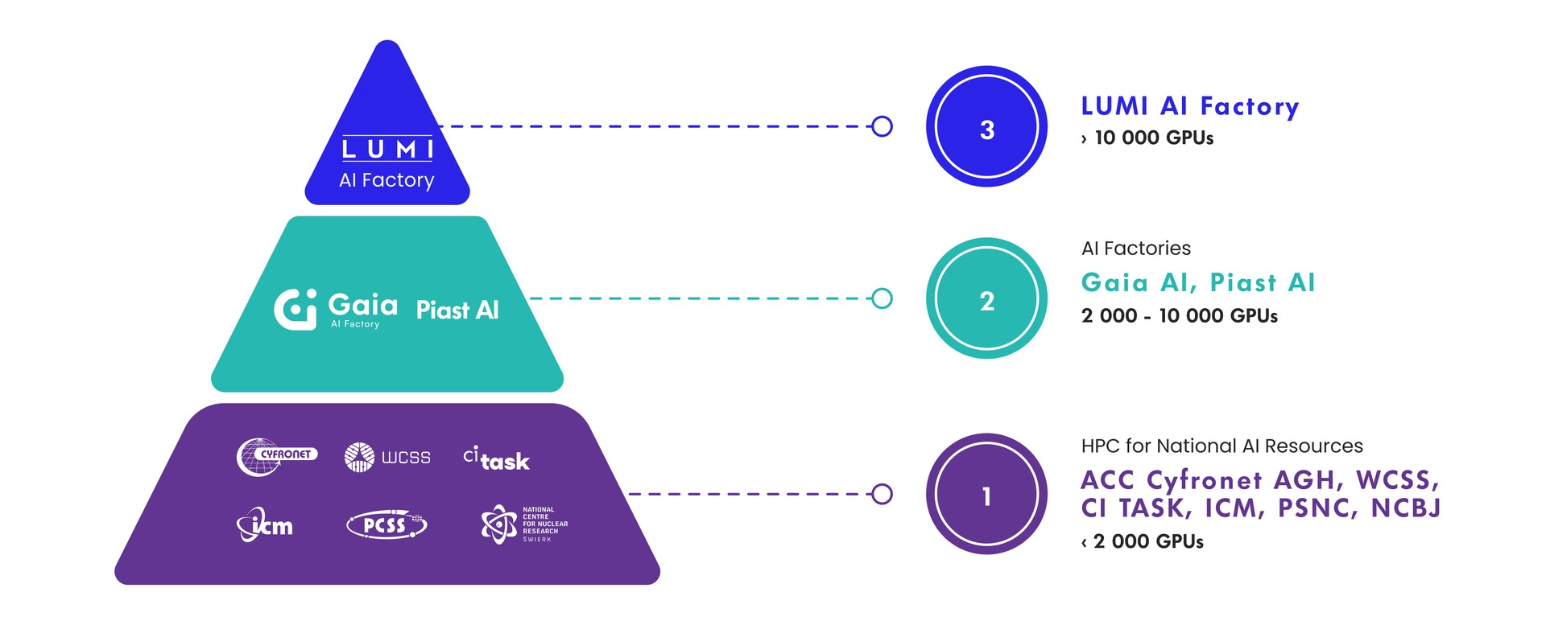

Slide 10

LUMI CONSORTIUM

Slide 11
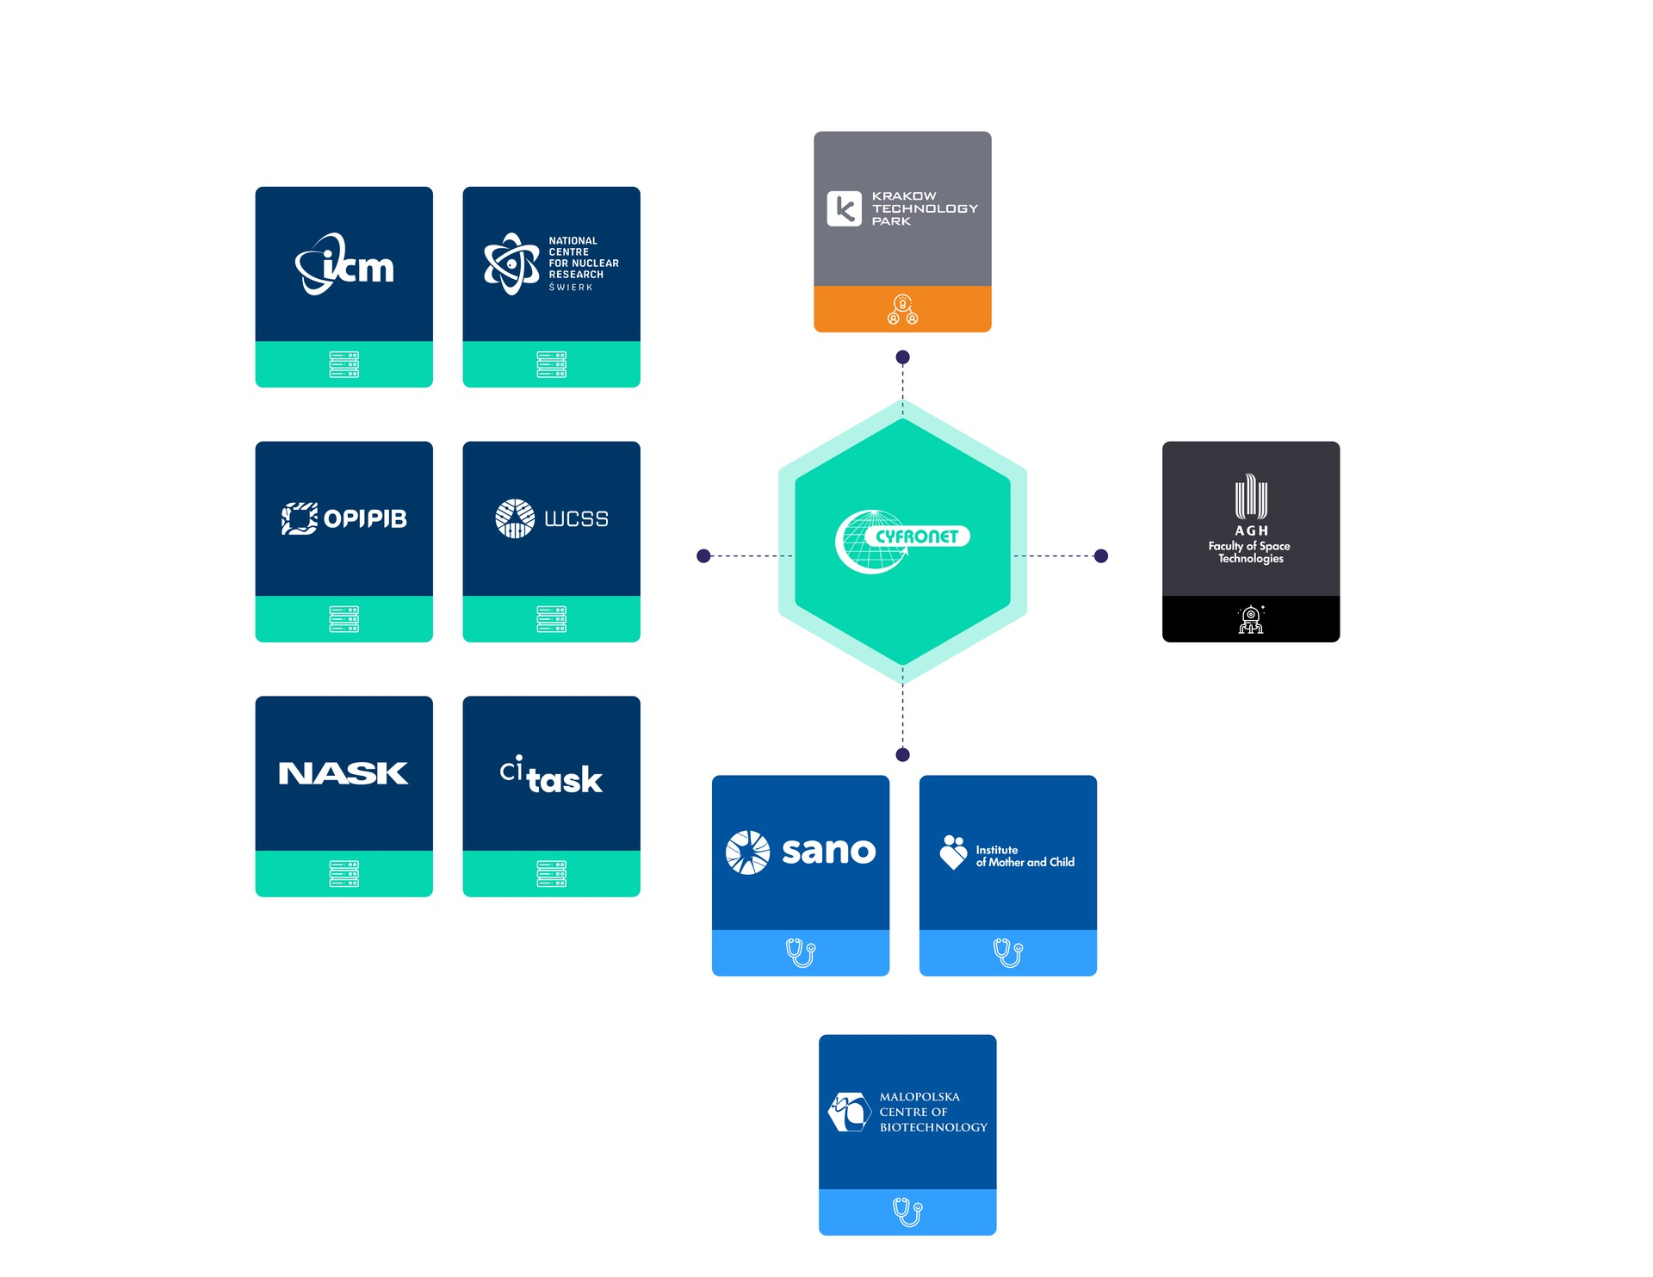
GAIA
CONSORTIUM

Slide 12
LUMI AI Factory - ONE STOP SHOP
Map your AI journey
Assistance in selecting and implementing AI methods for specific use cases
Support in deploying HPC and AI projects
Training in AI and large-scale HPC usage
Tailor-made AI courses
COMPUTING & DATA
EXPERT SUPPORT
TRAININGS
Computing resource
Dataset-as-a Service
AI training: fine-tuning, scaling, configuration, and code optimisation
MLOPs pipeline
Map clients AI journey
Assistance in selecting and implementing AI methods for specific use cases
Support in deploying HPC and AI projects
Training in AI and large-scale HPC usage
Tailor-made AI courses

Slide 13
Gaia as an AI-as-a-Service Laboratory
Map your AI journey
Assistance in selecting and implementing AI methods for specific use cases
Support in deploying HPC and AI projects
Training in AI and large-scale HPC usage
Tailor-made AI courses
HEALTH
LLMs
Space Technologies
Polish language models
LLM for public administration
Specialised translations
Medical text analysis
Medical Sandbox
AI Model Registry
Data Access
Integration with EHDS
Satellite data analysis
Predictive model
Collaboration
with European Space Agency

Slide 14
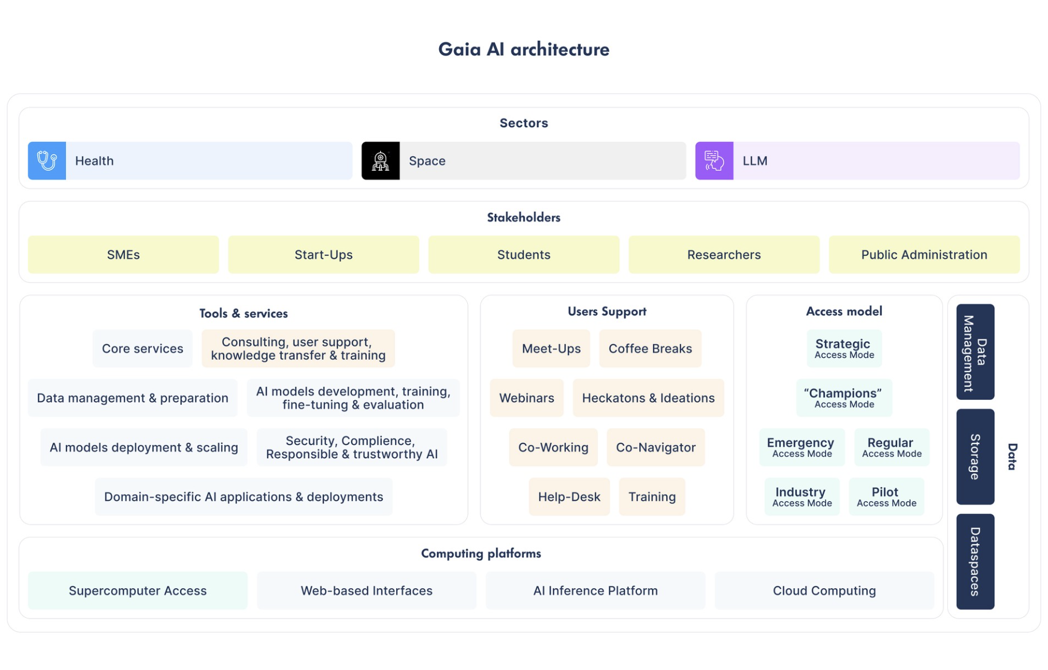

Slide 15

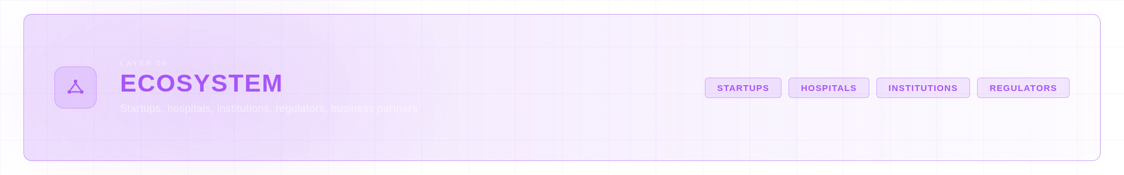
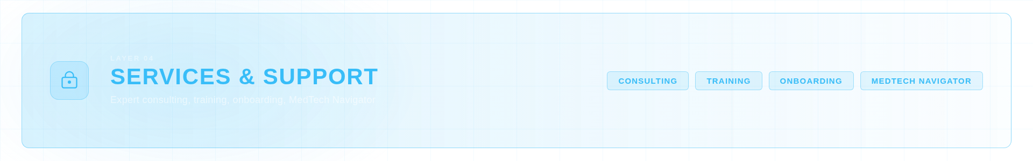
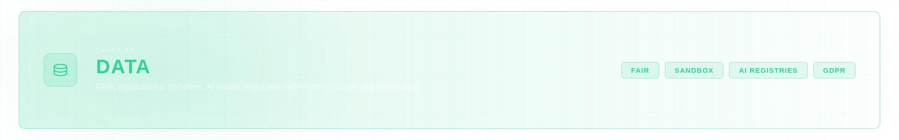
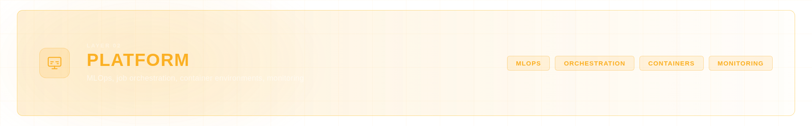
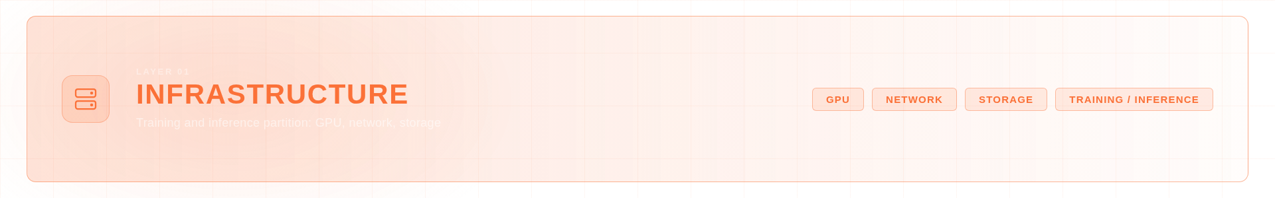
PL AI Factories

Slide 16
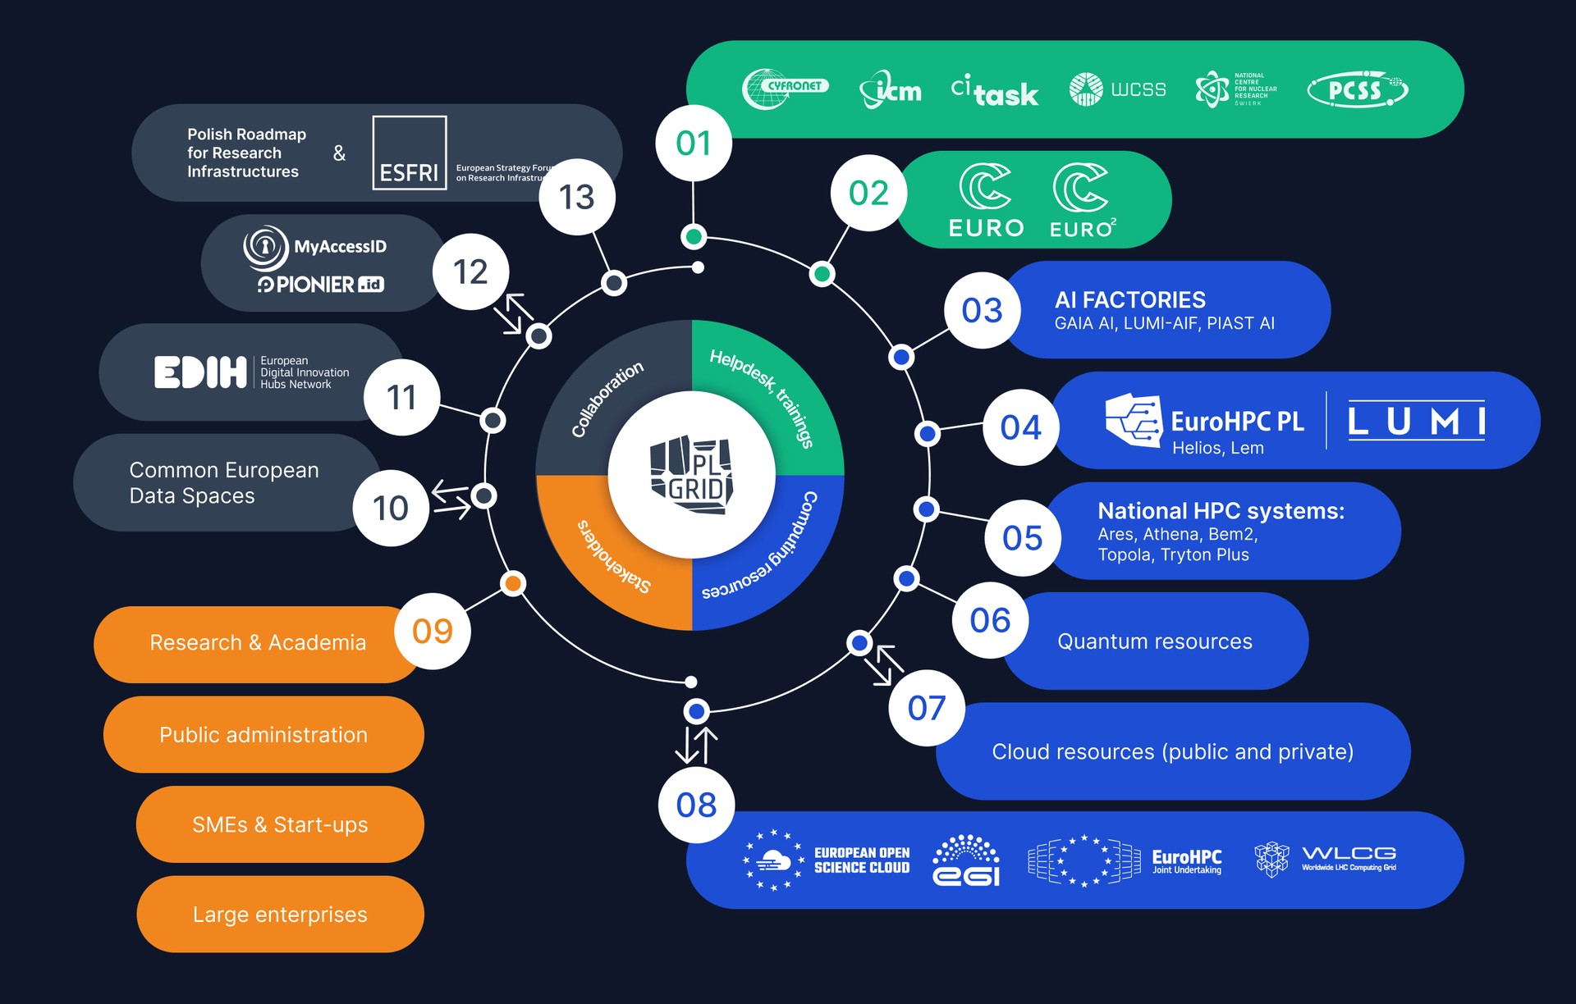
PLGrid infrastructure - foundation for unified access

Slide 17
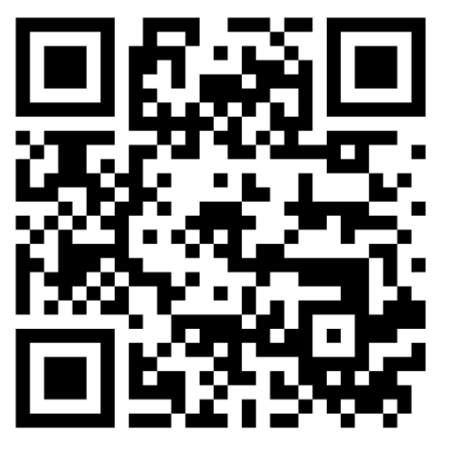


AI FACTORIES
lumi@cyfronet.pl
gaia@plgrid.pl

