Slide 1

KUKDM’26
•
IonTracks
Finite Element Ion Recombination Simulations for Ultra-High Dose-Rate (FLASH) Dosimetry on PLGrid
1
1
1,2
3
Radosław Benedykciński
Jakub Kaliński
Leszek Grzanka
Jeppe Brage
Christensen
✱
✱
1. AGH University of Krakow, al. Mickiewicza 30, 30-059 Kraków, Poland
2. IFJ PAN, Radzikowskiego 152, 31-342 Kraków, Poland
✱ presenting speakers
3. Paul Scherrer Institute, Forschungsstrasse 111, 5232 Villigen, Switzerland
1

Slide 2
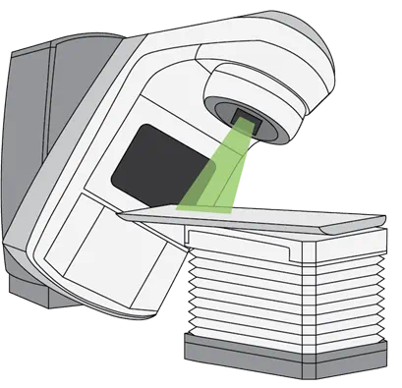
Radiotherapy in cancer treatment
KUKDM’26
•
IonTracks
10M+
Patients
Receive radiotherapy annually worldwide
High-Energy Ionising Radiation
Destroys cancer cells by damaging DNA
Issue: Healthy cells are also affected by radiation ⇒ risk of getting cancer from the therapy
2

Slide 3
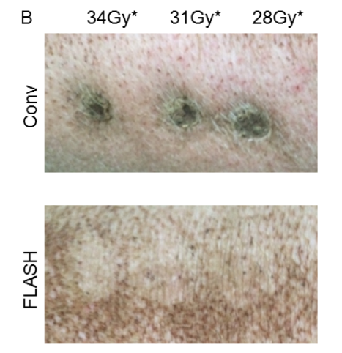

What is FLASH?
KUKDM’26
•
IonTracks
>40
Gray per second
Ultra-high dose rate in FLASH
~0.1
Gray per second
In conventional therapy
<1 s
Can take minutes
~30–40 Gy total
Delivered in fractions
~2 Gy per day over weeks
Summary: FLASH therapy aims to preserve tumor control while reducing normal-tissue damage
~50%
Damage reduction in healthy tissue
3

Slide 4
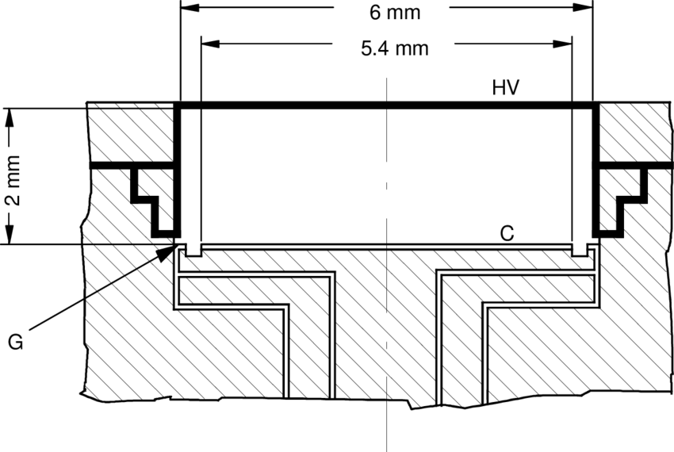
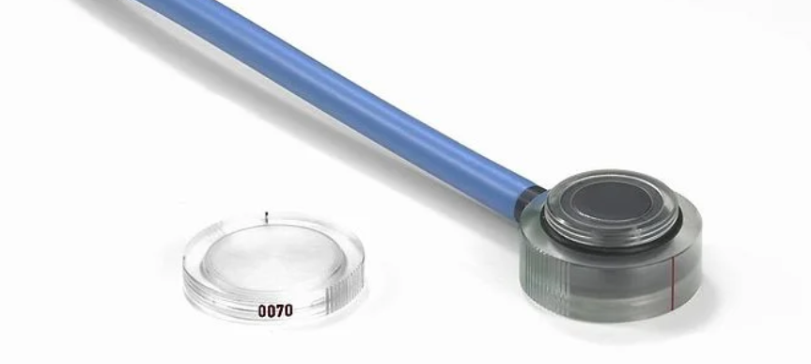
Dosimetry
KUKDM’26
•
IonTracks
Problems
Overdose
Excess dose increases damage to healthy tissue
Underdose
Insufficient dose reduces tumor control
Solutions
Dosimetry
Measurement of delivered radiation dose
Ionization Chambers
Standard detectors for dose measurement
Takeaway: Accurate dosimetry is a prerequisite for safe FLASH radiotherapy
Advanced Markus Chamber Type 34045
4

Slide 5
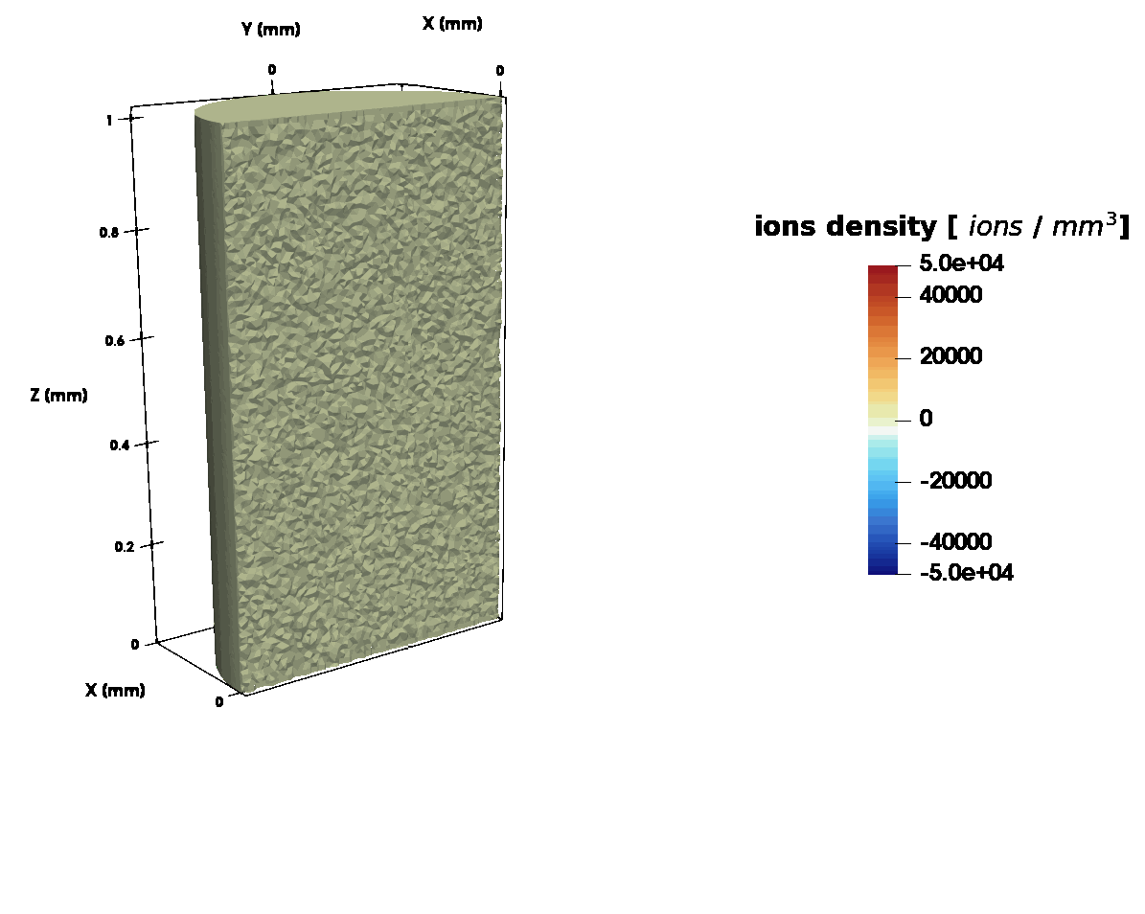
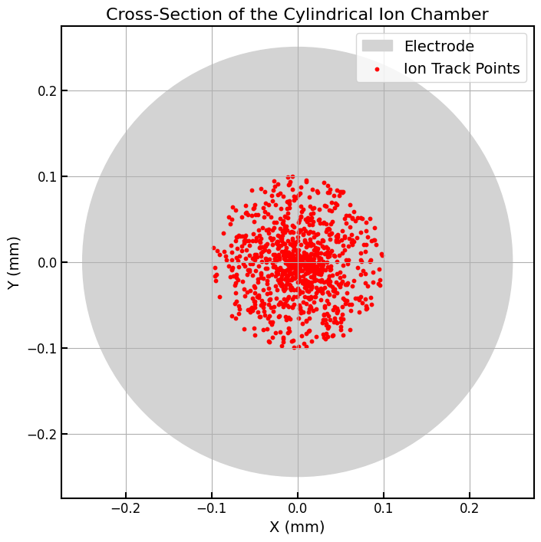
KUKDM’26
•
IonTracks
How does ionization chambers work?
Radiation creates ion pairs by ionizing the gas
Electric field separates charges. Ions drift toward electrodes with opposite sign
Collected charge ⇒ current. Measured current reflects dose
5

Slide 6
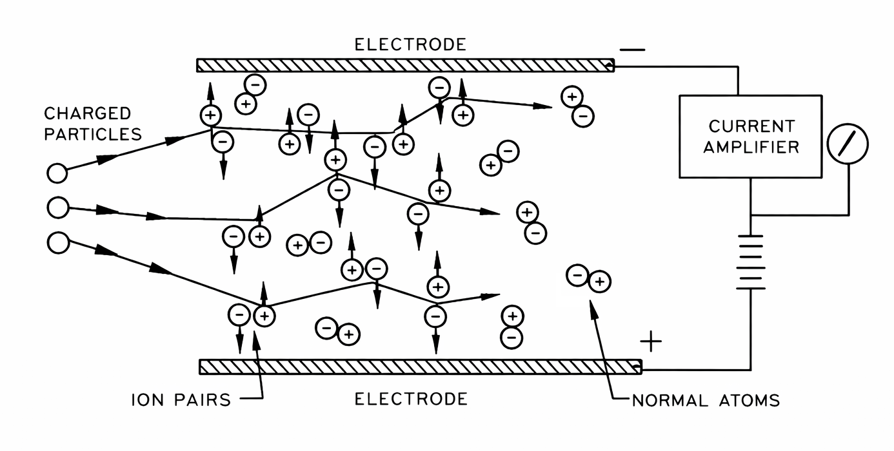
What is Ion Recombination?
KUKDM’26
•
IonTracks
Ion recombination
Opposite charges neutralize before collection
High ion density effect
More ions ⇒ higher recombination probability
Signal loss
Measured current is underestimated
Dose underestimation ⇒ overdose risk
6

Slide 7
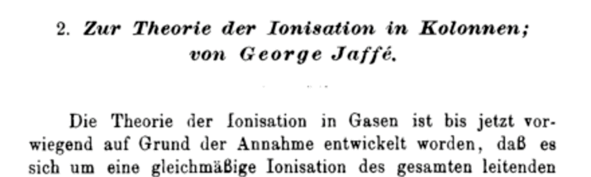
KUKDM’26
•
IonTracks
Analytical Models and why they fail in FLASH?
Classical Models
Developed in the early 1900s for conventional dose rates
Time-Scale Mismatch
UHDR beams challenge assumptions of classical theory
Nonlinear Recombination
Depends on charge density
Simplifying Assumptions
Uniform fields and low charge density
Field & Geometry Effects
Non-uniform electric fields
7

Slide 8
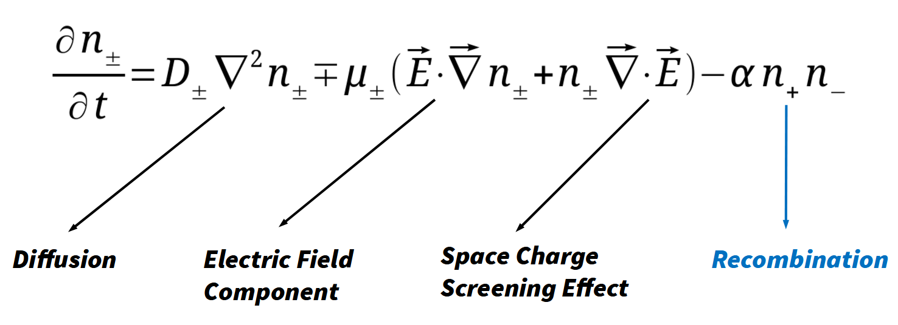
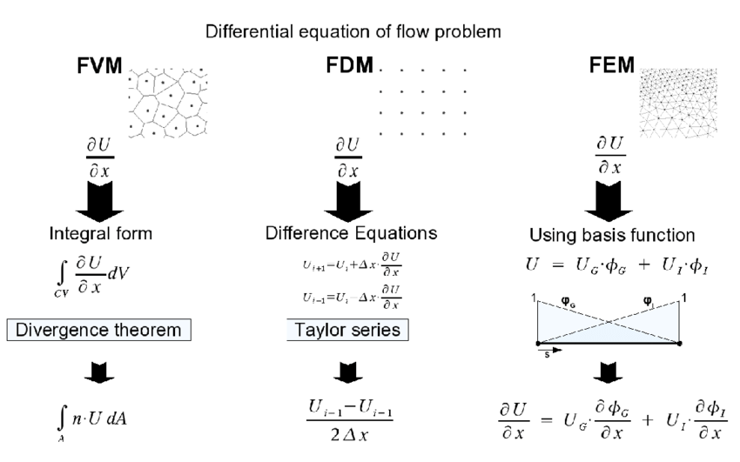
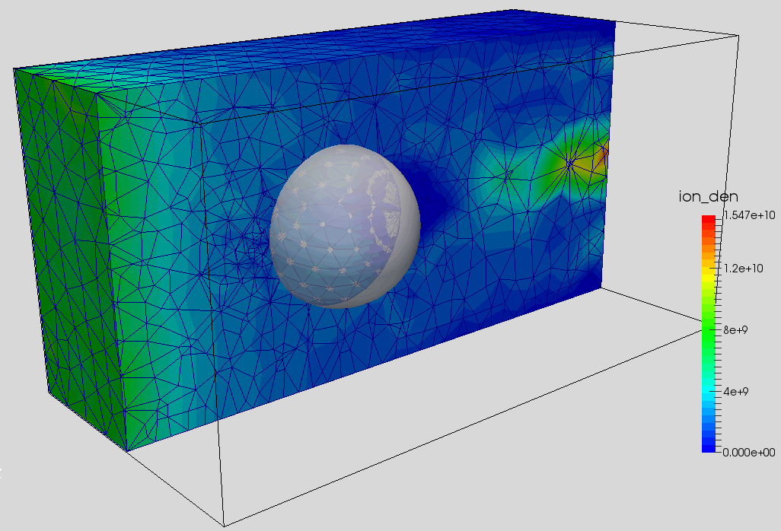
Why coupled PDEs + 3D FEM?
KUKDM’26
•
IonTracks
Time-Dependent PDEs
Resolve charge evolution from ns to ms
Nonlinear Physics
Recombination solved numerically
3D FEM Geometry
Real detector structure and boundaries
Field Changes with Charge
High charge density distorts the field
Summary: PDE-based 3D FEM properly captures UHDR physics
8

Slide 9

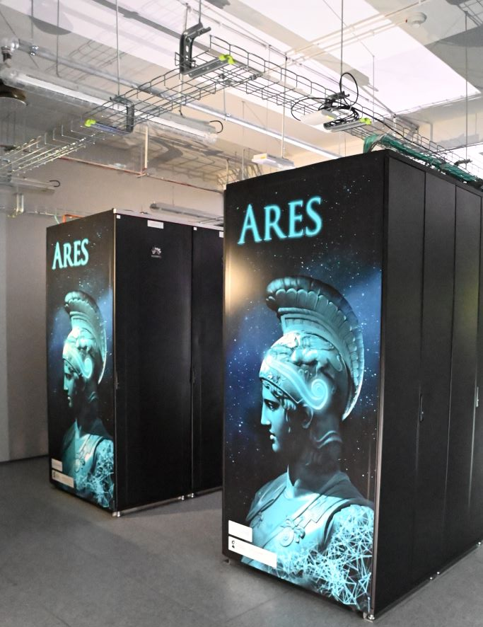
Computational Burden
KUKDM’26
•
IonTracks
Complex Physical Model
Nonlinear, time-dependent, 3D problem ⇒ requires HPC
Memory & I/O
~40 GB RAM per case & MEMFS used for fast and stable scratch I/O
Runtime Scaling
~30 min to many hours per run on HPC
Not One Run - Many
Full studies require large parameter scans
Takeaway: FLASH studies require HPC-scale campaigns
9

Slide 10




KUKDM’26
•
IonTracks
HPC Stack
Finite Element Layer
FEniCSx
Defines PDEs and assembles system matrices
Solver Layer
PETSc
Handles nonlinear solves and linear algebra
Parallel Execution
MPI
Distributes computation across nodes
Cluster Scheduling
SLURM
Manages jobs and resources
11
10

Slide 11



KUKDM’26
•
IonTracks
Reproducible Simulation Platform
YAML-defined cases
Configs define simulation cases allowing for reproducible simulation setups
SLURM job arrays
Structured multi-scenario execution
Conda environments
Consistent runtime across systems
MEMFS scratch
Reliable high-frequency I/O
Reproducibility
Same config + env ⇒ same trends
11

Slide 12
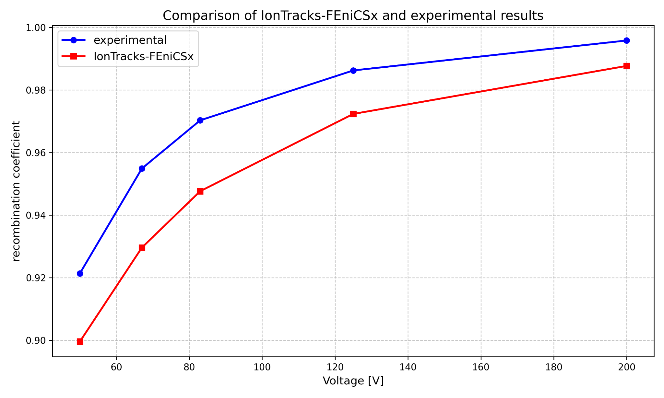
KUKDM’26
•
IonTracks
Results: Model Validation
Consistent with Jaffé theory
Recombination trends match expected behavior
Stable numerical behavior
Mesh refinement shows convergence
Agreement with experiments
Within expected range
12

Slide 13

Acknowledgements and Key References
KUKDM’26
•
IonTracks
Acknowledgements
Numerical experiments performed on Ares (ACC Cyfronet AGH, grant plgccbmc14)
Supported by PLGrid infrastructure and collaborators
Validation Data (DCPT 2019)
Proton beam experiments at Danish Center for Particle Therapy
Advanced Markus ionization chamber (2 mm gap)
Energies: 70–244 MeV, voltages: 50–200 V
Multi dose-rate conditions
Key references
Jaffé (1913), Boag (1950)
FLASH dosimetry literature
FEniCSx / PETSc frameworks
Thank you for your attention - questions are welcome!
13

Slide 14
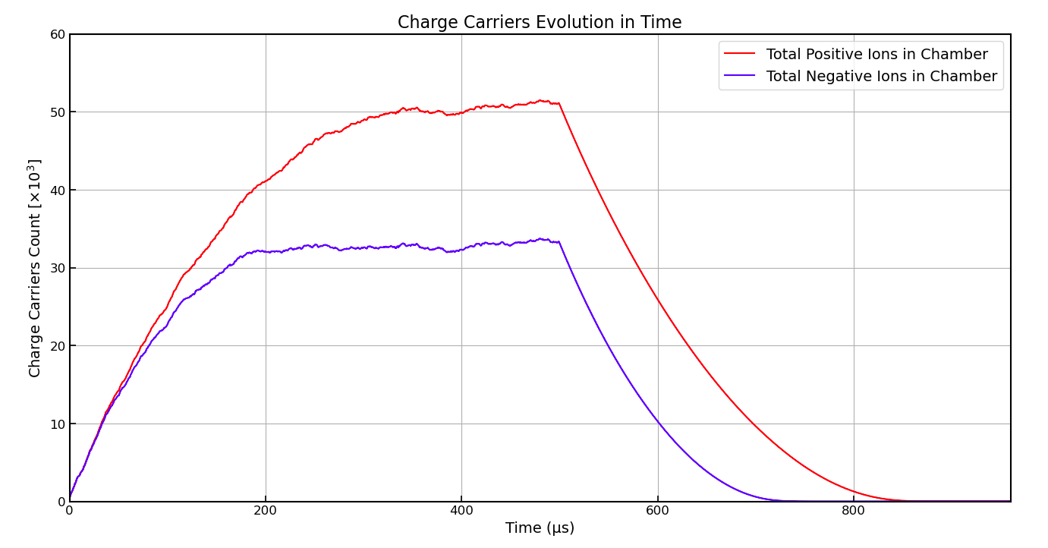
KUKDM’26
•
IonTracks
+

