Slide 1
Energy Efficiency
Ampere Altra, Altra Max, and
AMD Bergamo
WLCG GDB
CERN, Geneva
11th October 2023
David Britton GridPP Project Leader
University of Glasgow

Slide 2
Outline
Brief overview on the technology landscape:
ARM Architecture and Neoverse Compute Subsystem.
AMPERE (ARM) Roadmap.
AMD (x86) Roadmap.
New results on Altra Max and AMD Bergamo:
Benchmarking: HEPScore
Energy Efficiency: HEPScore/Watt
Comparison with other Measurements.
Comment on clock Frequency.
Conclusions and Outlook.
Presenting work from the Glasgow team:
Emanuele Simili
Dwayne Spiteri
Gordon Stewart
Sam Skipsey
Bruno Borbely

Slide 3
ARM Ecosystem
ARM is an architecture: Manufactures can buy a license to build a system, but this is a slow and risky process.
As an alternative, ARM released Neoverse CSS in 2018.
CSS offers more of a multi-core system. Presumably costs more than a license but de-risks development.
https://www.nextplatform.com/2023/08/31/arm-gets-closer-to-creating-full-blown-server-cpu-designs/?td=rt-9cp

Slide 4
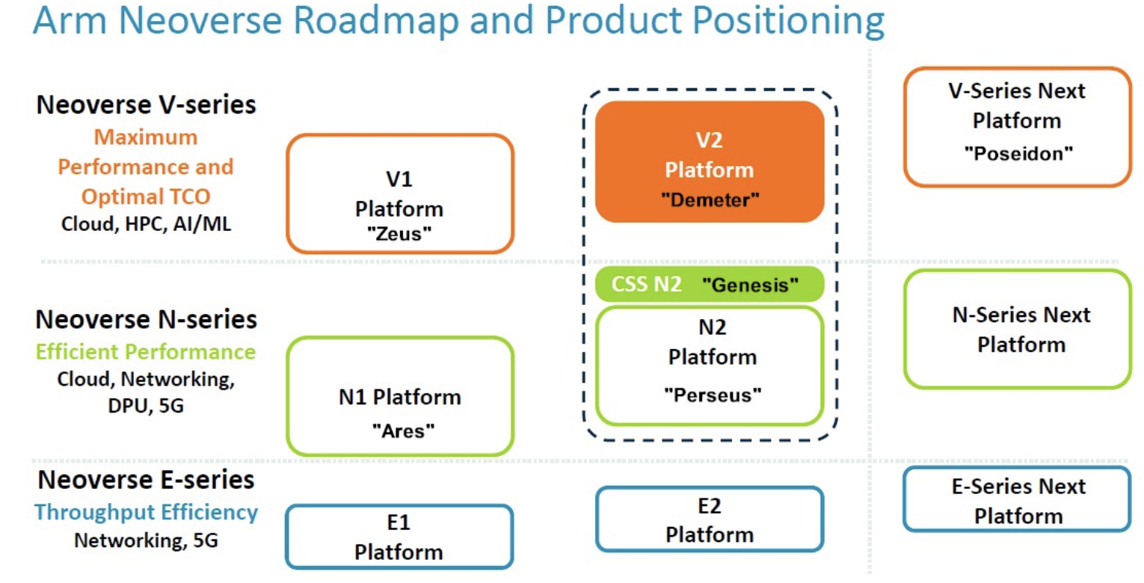
ARM Neoverse CSS
NVIDIA Grace
AWS Graviton3
AWS Graviton2
Ampere Altra/Max
https://www.nextplatform.com/2023/08/31/arm-gets-closer-to-creating-full-blown-server-cpu-designs/?td=rt-9cp
Notes:
The Neoverse V-Series processors are intended for high-performance computing.
The Neoverse N-Series processors are intended for core datacenter usage.
The Neoverse E-Series processors are intended for edge computing. They are designed for increased data throughput at decreased power consumption.

Slide 5
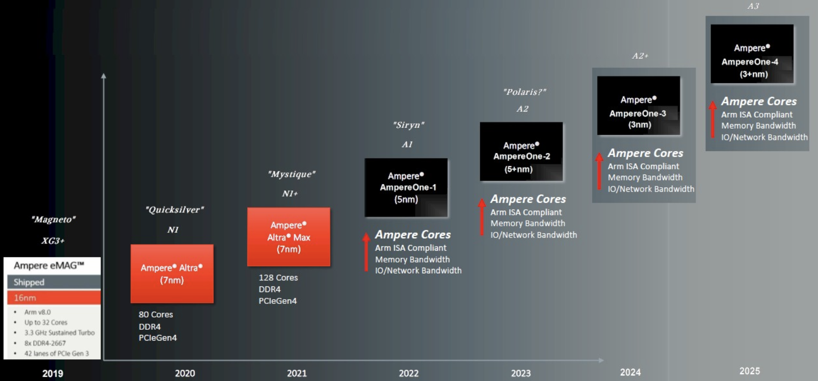
Ampere Roadmap
AmpereOne (released but not available to us yet) is Ampere’s own system; not based on Neoverse
https://www.nextplatform.com/2023/05/18/ampere-gets-out-in-front-of-x86-with-192-core-siryn-ampereone/

Slide 6
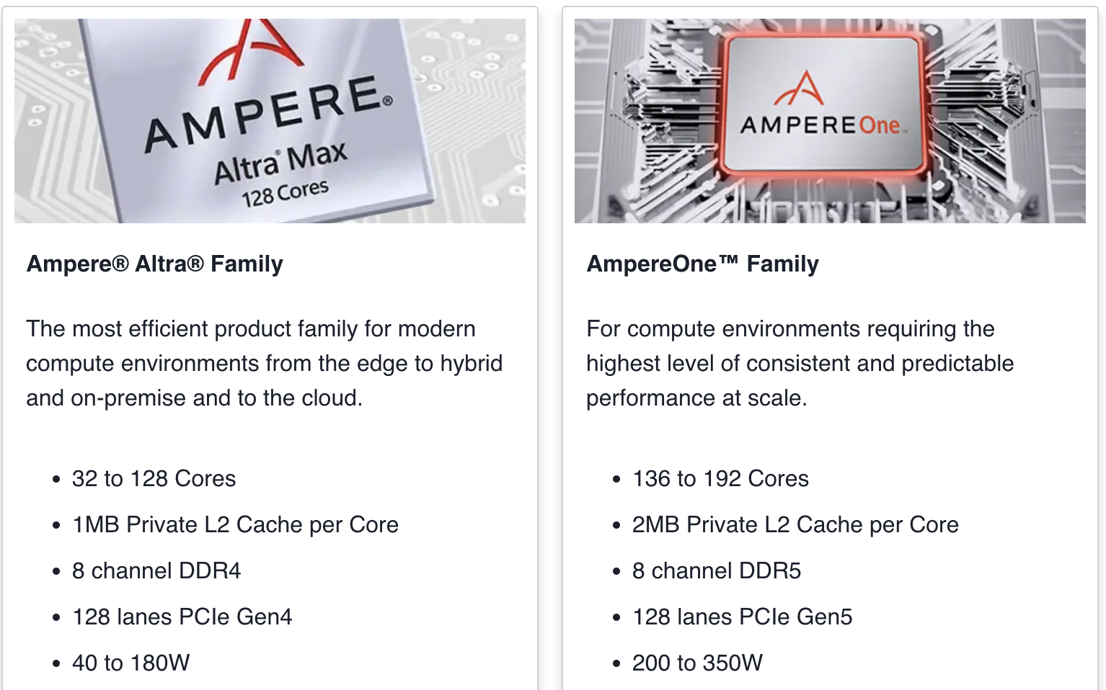
AmpereOne vs Altra
https://amperecomputing.com/products/processors

Slide 7
AmpereOne vs AMD
https://www.nextplatform.com/2023/05/18/ampere-gets-out-in-front-of-x86-with-192-core-siryn-ampereone/

Slide 8
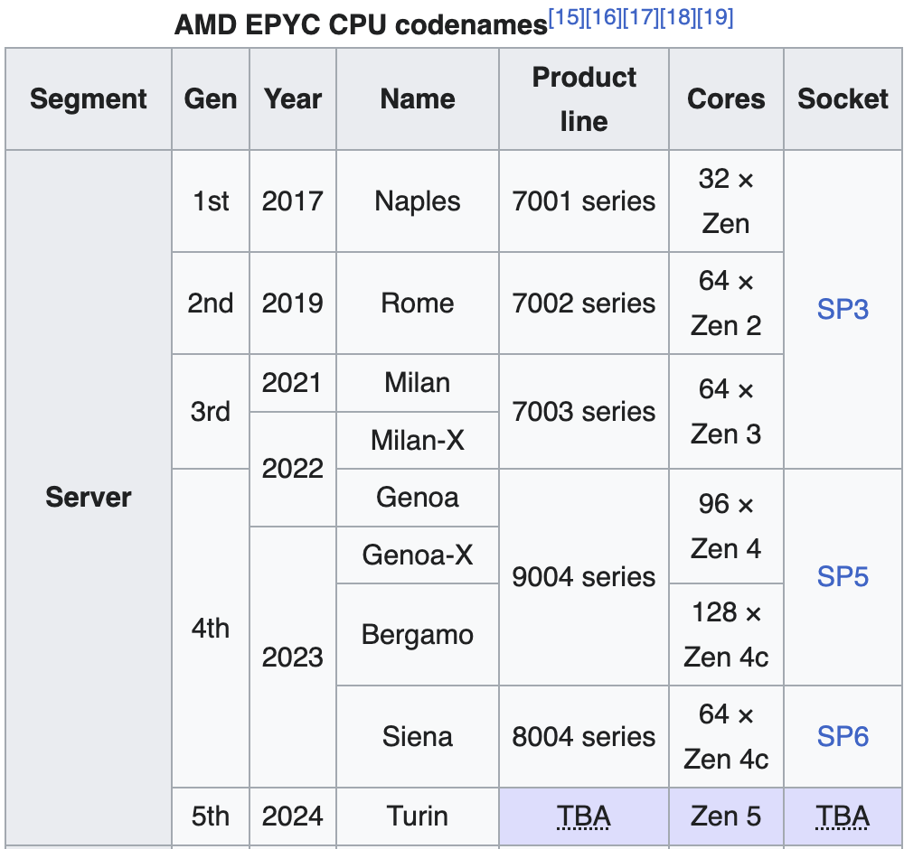
AMD Roadmap
Bergamo, offers up to 128 cores per socket, utilizing a modified version of the Zen 4 core optimized for power efficiency: Cache per core is reduced from 4 MB to 2 MB, and the frequency of the cores is reduced.
On Sep 18th, 2023, AMD launched their low power Siena (new socket but uses the same Zen 4c core as Bergamo) only has up to 64 cores per processor and no dual-socket support. Only 6 channels of DDR5.
https://en.wikipedia.org/wiki/Epyc

Slide 9
ARM @ Glasgow
In 2022 we purchased Ampere Altra 80core (single socket) machine and a similar priced AMD EPYC 7643 48/96HT core test machines (reported results at last two WLCG workshops).
In 2023, Ampere© donated 12 x 160 core dual socket Altra 80c machines. 11 (1760 cores) now installed as initial Glasgow ARM-farm. The set-up, and some results, will be presented today.
Awaiting delivery of 144 core Grace test system.
Having tested the Ampere Altra Max (results presented today) we intend to procure a second ARM-farm (~1000 cores) based on the Altra Max, this financial year.
For comparison, we have also measured energy efficiency of an AMD Bergamo and are negotiating access to an AMD Siena.

Slide 10
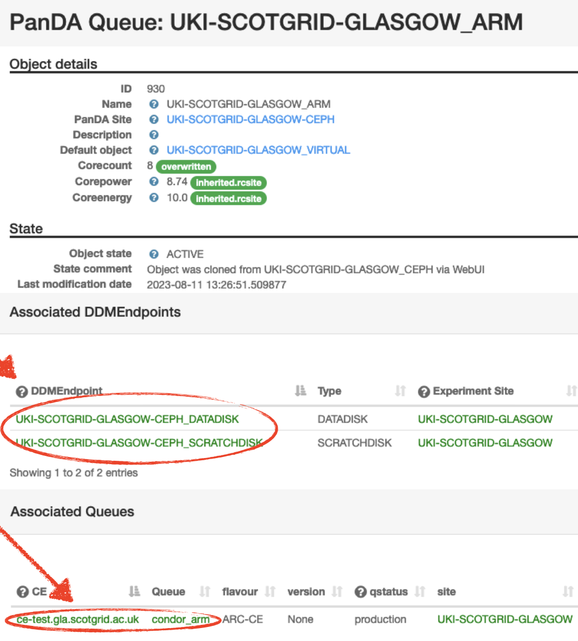
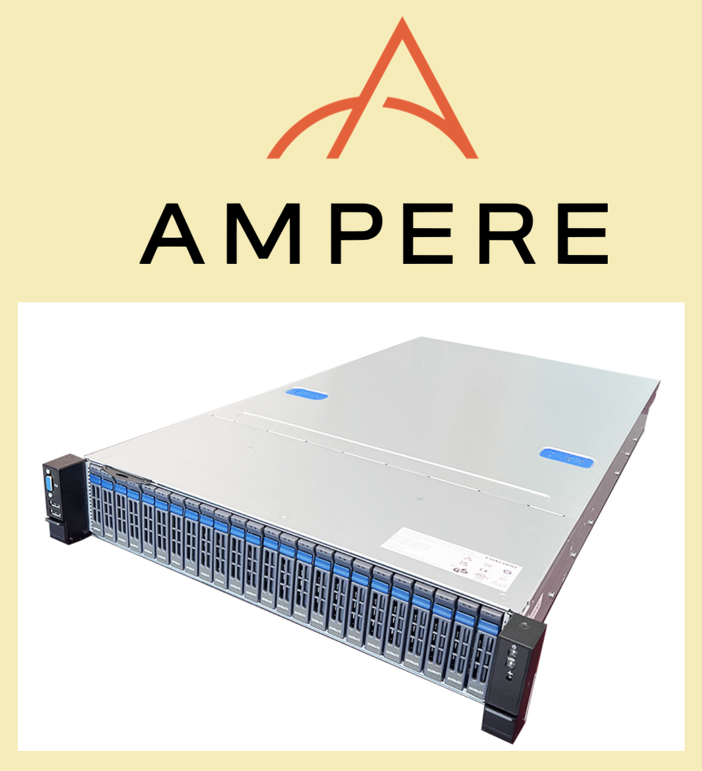
Current Glasgow Setup
~16,000 x86 cores
x86 jobs
Site Queue
Condor 8
Arc CEs
ARM jobs Test Queue
1760 ARM cores
Condor 10
Arm Farm: 11 x 2 x Altra Q80-30
ATLAS is first to test.
CMS, and then ALICE, will follow.
ATLAS repeating 50m event validation (sim, reco, derivation) already run on Google.
Just finishing…
2 sockets
160 cores
3.0 GHz max
512 GB memory

Slide 11
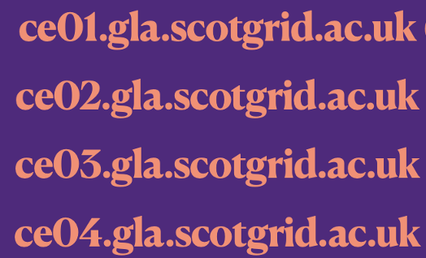
Next Glasgow Setup
x86
Queue
~16,000 x86 cores
Arc CEs
Condor 10
ARM Queue
1760 ARM cores
Future?
For user, rather than production jobs, a single site queue might be better, but that would require the architecture to be specified in the JDL or perhaps handled by the pilot framework?
Better to keep it simple?
Issues are minimising additional work for site to provide heterogenous resources, and making it as transparent as possible for users.

Slide 12
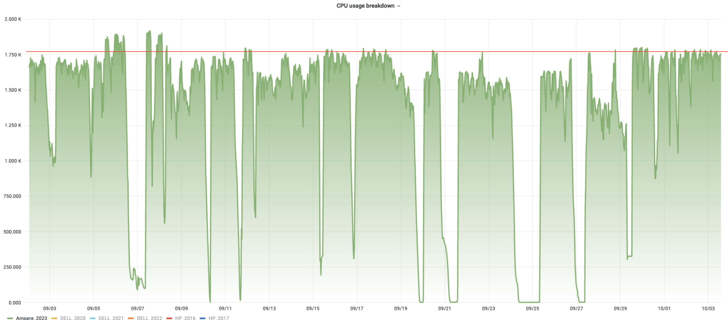
ATLAS Experience
Atlas Issue
RAL Issue
Site Issue
Up - grade
etc… i.e. business as usual!
Sep 2023
ATLAS 50m event validation now just finishing. We also ran a subset on x86 at Glasgow, and will evaluate in the next couple of weeks.

Slide 13
Pre GDB?
After evaluation by ATLAS, CMS, ALICE and most likely LHCb, it might be interesting to have a pre-GDB to discuss… Feb++ ?
The important discussion is about whether ARM resources can be pledged in September 2024 to deliver resource in 2025.
The UK will not *need* this to be agreed for 2025, but it would be useful (and important for sustainability and competition).
It will be useful for the GDB to form a view and be able to give a recommendation to the MB.

Slide 14
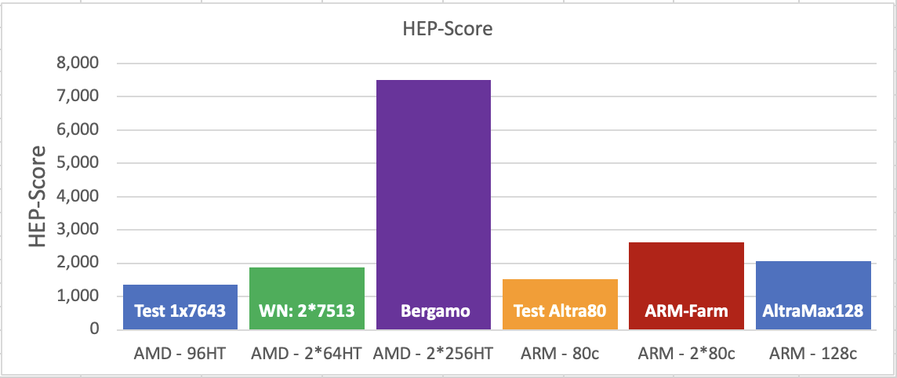
HEPScore Measurements
Machine | CPU | Threads | HEPScore
Test AMD | 1x EPYC 7643 HT | 96 | 1359
Std AMD WN | 2x EPYC 7513 HT | 128 | 1887
AMD Bergamo | 2x EPYC 9754 HT | 512 | 7497
Test ARM | 1x ALTRA 80 | 80 | 1513
Farm ARM | 2x ALTRA 80 | 160 | 2619 ??
Ampere Max | 1x ALTRA Max | 128 | 2065
x4
Not x2 ??

Slide 15
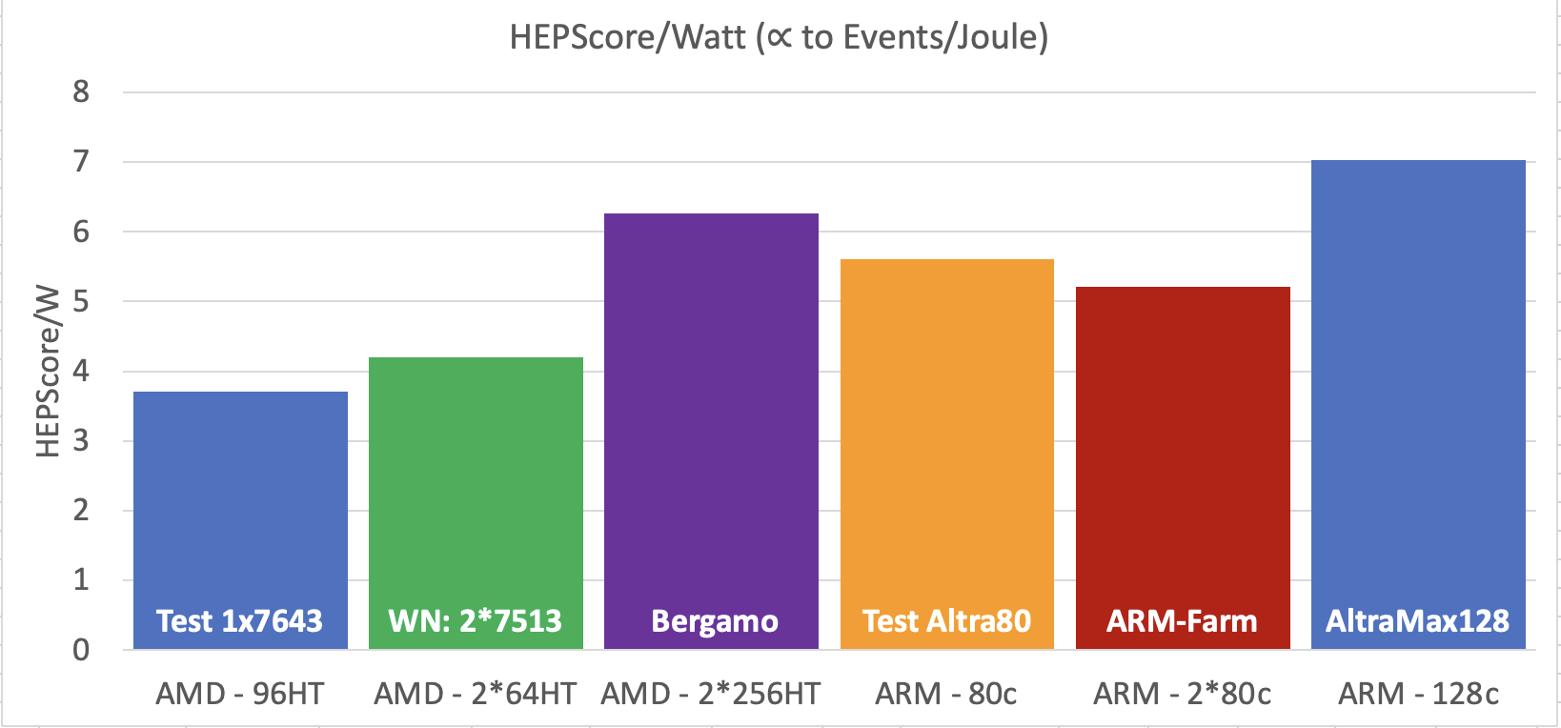
HEPScore/Watt
Machine | CPU | Threads | HS/Watt
Test AMD | 1x EPYC 7643 HT | 96 | 3.7
Std AMD WN | 2x EPYC 7513 HT | 128 | 4.2
AMD Bergamo | 2x EPYC 9754 HT | 512 | 6.3
Test ARM | 1x ALTRA 80 | 80 | 5.6
Farm ARM | 2x ALTRA 80 | 160 | 5.2 ??
Ampere Max | 1x ALTRA Max | 128 | 7.0
50% improvement from 7513 WN
25% improvement from 80c
Note added: We use Average Watts to calculate HS/Watt. Other people also use Max Watts, so care needs to be taken comparing numbers.

Slide 16
Max or Average Power?
Max is sensitive to the spikes; will underestimate HS/Watt .
Average is sensitive to start-up phase, which is relatively long in short benchmarking jobs; will overestimate HS/Watt.
Most accurate metric might be “Max Average” over a few minutes.

Slide 17
Results Comparison
2
HEPScore Measurements of single-socket machines agree well (<2% std) at three or four sites.
Dual-socket measurements (moving from test to production machines) don’t seem to scale quite as expected; to be investigated further.
There is about a 23% difference in HS/Watt using Peak or Average power.

Slide 18
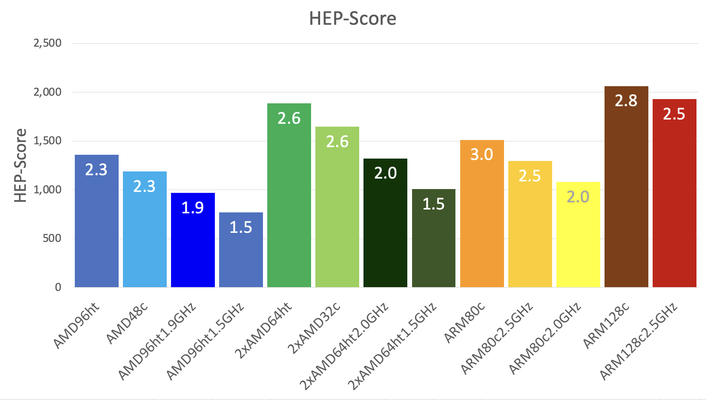
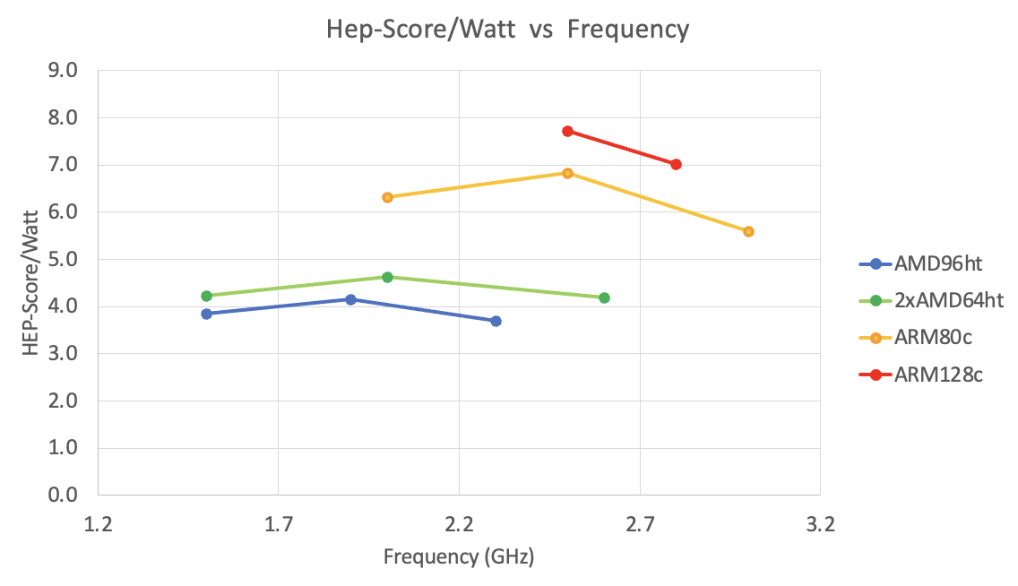
Energy Efficiency vs Clock
Running one step below max clock frequency seems to be the sweet-spot for all CPUs tested.
On ARM128, frequency reduction lowers HEPScore by 6.5% but saves another 9% of the energy.
No data on Bergamo (bug?)
Clock Frequency GHz

Slide 19
Conclusions and Outlook
128-core ALTRA-Max is most energy efficient CPU we have tested.
AMD has made big improvements to energy efficiency with Bergamo.
Running CPU one step below max-frequency seems to be sweet-spot in terms of energy efficiency.
The dual-socket Ampere machines have not yet been shown to give 2x the single socket performance; but this is probably not a big deal.
Multiple sites agree on the HS23 benchmarks of Ampere machines.
The ability to use both x86 and ARM architectures will allow sites to optimise power usage and promote competition during procurements.
We have ordered a Grace test machine. Expect it to be fast but not sure how competitive it will be in terms of HEPScore/Watt.
We hope to get access to an AMD Siena test machine in the next few weeks.

