Slide 1
Evaluating Synthetic vs. Real Dynamic Vision Sensor Data for SNN-Based Object Classification
Mustafa Sakhai¹, Kaung Sithu¹, Min Khant Soe Oke¹, Szymon Mazurek^{1,2}, Maciej Wielgosz^{1,2}
¹ AGH University of Krakow, al. Mickiewicza 30, 30-059 Kraków, Poland
² ACC Cyfronet AGH, Nawojki 11, 30-059 Kraków, Poland
Akademia Górniczo-Hutnicza im. Stanisława Staszica w Krakowie
AGH University of Krakow
03.04.2025

Slide 2
Problem Statement
In Autonomus driving the traditional frame-based cameras can introduce significant latency in dynamic scenarios and elevated power consumption.
Physical Dynamic Vision Sensors (DVS) are expensive and not widely or easily accessible as RGB sensors.

Slide 3
Our research Objective
Develop a method to generate synthetic event-based data as a practical alternative to physical DVS sensors.
Apply a consistent RGB-to-DVS conversion pipeline across different datasets.
Use synthetic DVS data as input to Spiking Neural Networks (SNNs) for pedestrian detection tasks.
Investigate: Can software-based RGB-to-DVS conversion maintain high quality and fidelity?

Slide 4
Datasets
Joint Attention in Autonomous Driving (JAAD) Dataset
The data consists of 346 high-resolutions video clips (5-15s)
Only RGB video clips
The Dataset of Manufacturing Tasks (DMT22) Dataset
Encompasses five classes of representative manufacturing primitives
RGB and DVS video clips

Slide 5
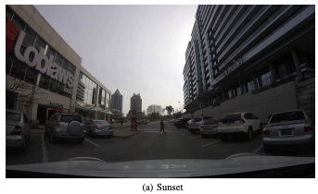
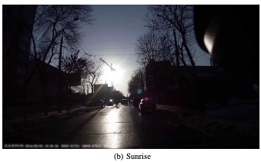
JAAD Dataset

Slide 6
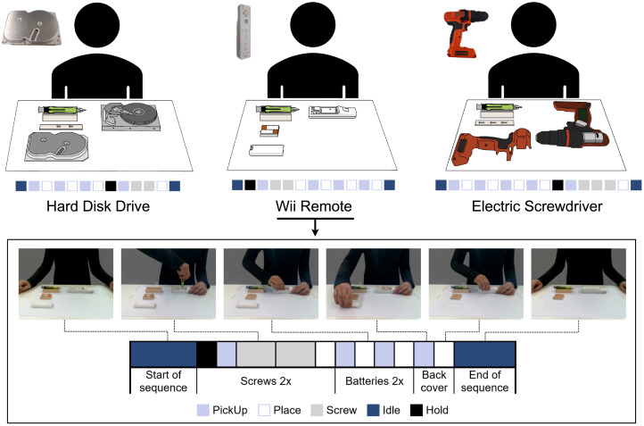
DMT22 Dataset

Slide 7
Here's how we tackled a major challenge toward our goal using the two datasets
The main goal: Investigate pedestrian detection using Dynamic Vision Sensors (DVS) and Spiking Neural Networks (SNNs).
Initial Dataset: JAAD (Joint Attention for Autonomous Driving) – provides rich RGB data but lacks native DVS recordings.
Challenge: We developed a method to convert RGB frames to synthetic DVS, but the accuracy and realism of this conversion were uncertain.
Solution: Introduced the DMT22 dataset, which contains paired RGB and real DVS data.
Approach:
Convert DMT22 RGB to synthetic DVS using v2e.
Compare synthetic DVS with corresponding real DVS from DMT22.
Outcome: This allowed us to validate the quality of the synthetic DVS and justify its use in experiments based on the JAAD dataset.

Slide 8
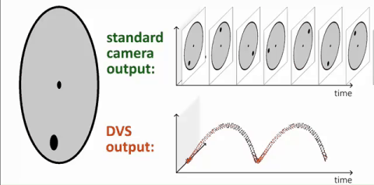
Dynamic Vision Sensor (DVS)
DVS operates asynchronously, capturing changes in light intensity at the pixel level and recording events only when a change in brightness occurs.

Slide 9
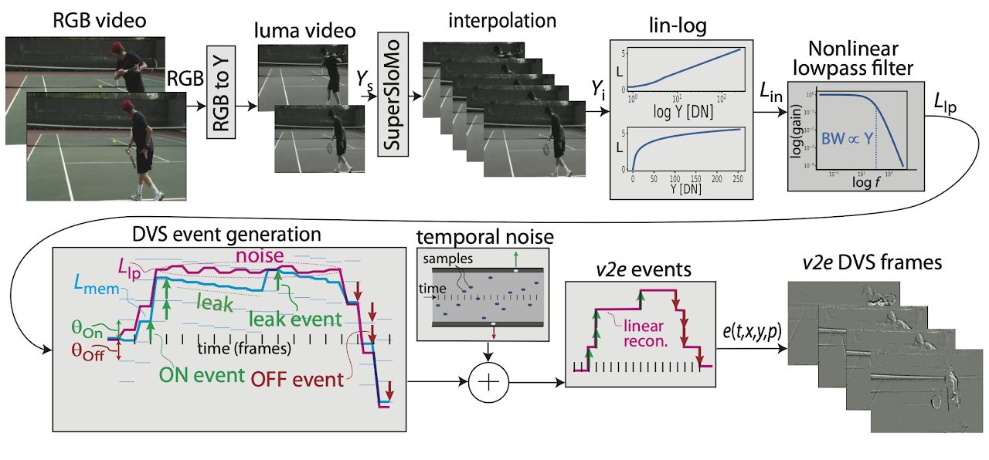
v2e: Video to Events
Python torch + opencv code

Slide 10
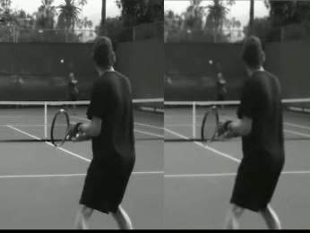
v2e: Output
https://sites.google.com/view/video2events/home

Slide 11
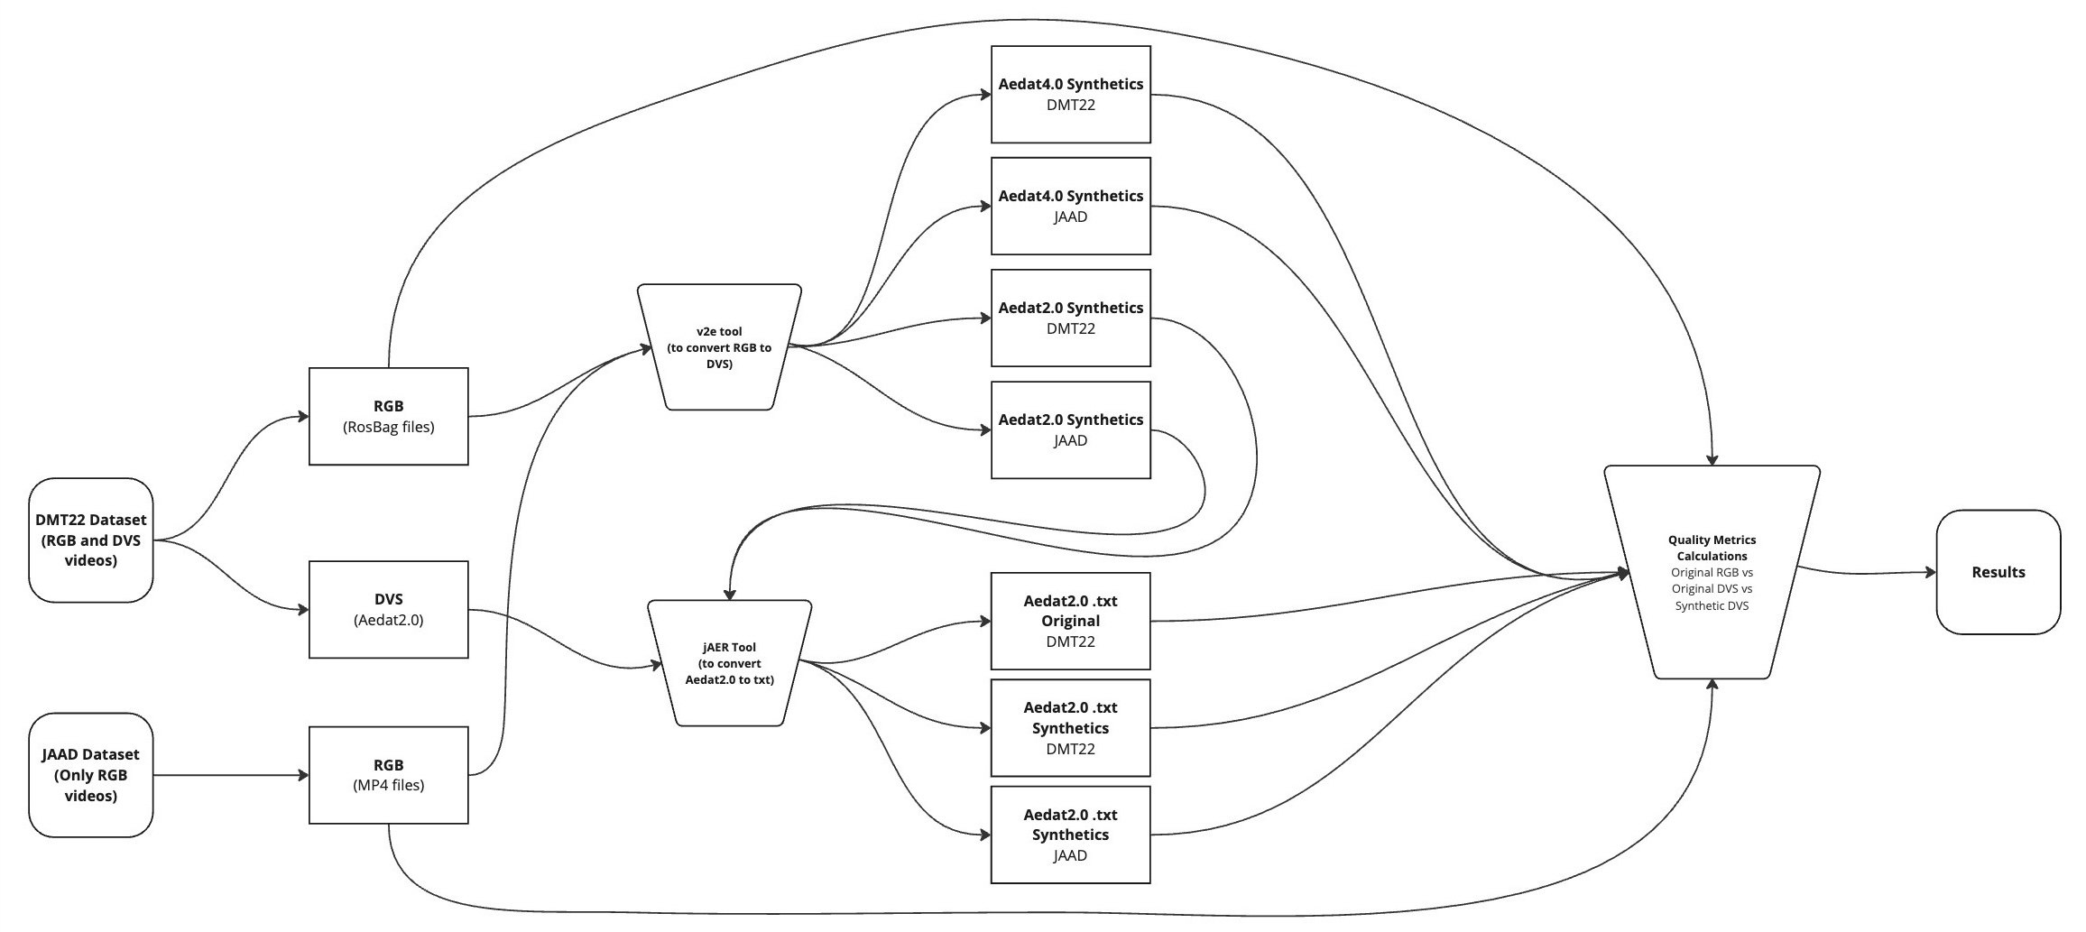
Experiments workflow

Slide 12
Experiments resources
Compute and Storage Resources: Experiments were carried out on NVIDIA A100 GPUs within the PLGrid infrastructure, optimizing event-driven processing. Additionally, metric evaluations were conducted using Cyfronet's Athena supercomputer, ensuring robust computational support.
v2e Tool (Video Frames to Realistic DVS Events): to convert from RGB to DVS.
jAER software (Java Address-Event Representation) and Python (dv & aedat) to parse DVS events files.
Algorithm: We implemented a Spiking Neural Network (SNN) model for object detection, utilizing event-driven computations to enhance efficiency.
Notes:
SNNs trained with surrogate gradient method

Slide 13
Results

Slide 14
Conclusions and future work
Synthetic DVS demonstrated a resolution very close to that of real DVS events.
AEDAT 4.0 demonstrated superior temporal precision and polarity accuracy.
Improve synthetic data generation pipelines to address noise and enhance polarity accuracy, ensuring more reliable event-based datasets.
Explore hybrid DVS-RGB systems to combine the temporal precision of DVS with the spatial detail of RGB data, enabling robust performance across diverse scenarios.
This research was supported by the PLGrid infrastructure on the Athena computer cluster, under grants PLG/2024/017775 and plgdyplomanci6.

Slide 15
Thank you!
Mustafa Sakhai | msakhai@agh.edu.pl

